Slide 1
Unit One Review

Slide 2
Making inferences
An inference is when we use our prior knowledge combined with evidence from the text to make a logical guess about the text.
“I looked at the permission slip, wishing there were some special words I could say to get Mama and Papa to sign it. Around me, everyone in my homeroom was talking about the Spring Fling. Mama says she thinks the school is strange to have parties and events after school when children should be doing their homework.”
Based on the quote above from My Favorite Chaperone,
what can we infer about Mya’s parents’ views/values: _______________________
Mya’s views/values: ____________________

Slide 3
Direct Characterization
Direct characterization is when text gives specific details about a character.
Example: Suzy has brown hair, blue eyes, and is a kind person.
This is direct characterization because it is specifically describing Suzy’s appearance and personality.

Slide 4
Indirect Characterization
Indirect characterization is when a reader finds out a about a character’s appearance or personality through the character’s actions, thoughts, dialogue (what they say), or what other characters think or say about them.
Ex: Sam screamed at his mom, “I want a lollipop, and I want it NOW!”.
Based on this evidence, we infer that Sam spoiled, or rude in order to get his way.
This is indirect characterization because we (as readers) must make inference based on Sam’s actions to figure out his personality.

Slide 5
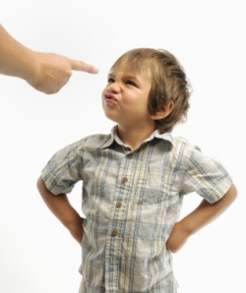
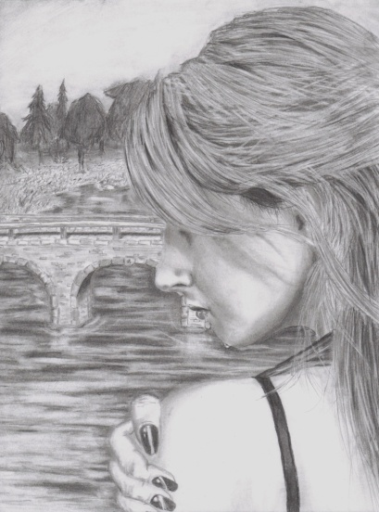
Readers sometimes must infer to gather indirect details about a character
Example: If a mother calmly tells her son it's time for bed and he responds by saying, 'No, I don't have to do what you say! I'm staying up all night!'
What can we infer?
Example: A character smiles shakily and says, “That’s all right,” while turning away to hide a tear.
What can we infer?

Slide 6
Author’s purpose
Author’s purpose is generally the author’s reason for writing a text
To inform, persuade, entertain, or explain
Author’s purpose can also be more specific.
Ex: what is the author’s purpose in including the story about Mya’s aunt in “My Favorite Chaperone”?
To give background information about how Mya and her family came to America

Slide 7
Imagery
Imagery is the use of very descriptive language, or sensory details, which describe the way something looks, feels, tastes, sounds, or smells.
Authors often use imagery in order to help the reader picture what’s happening in the text
Example of imagery from The Latehomecomer:
“It was in a poor neighborhood with houses that were ready to collapse– wooden planks falling off, colors chipping away, sloping porches– and huge, old trees.”
This imagery is describing the house Yang’s family purchases at the beginning of the text. We can infer that the house is old and kind of run-down.

Slide 8
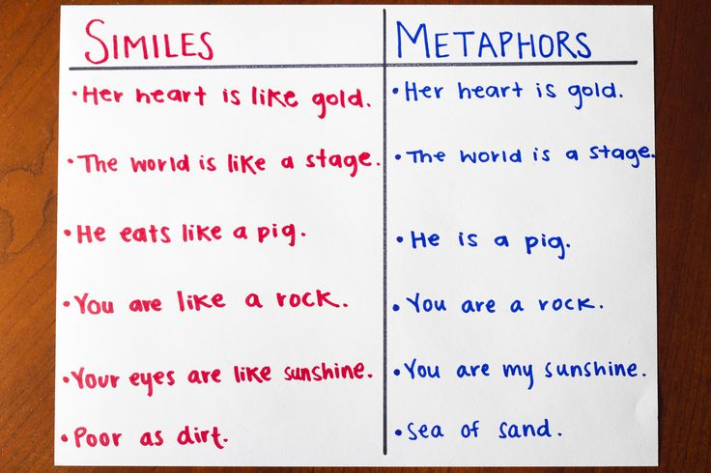

Slide 9
Extended Metaphor
An extended metaphor is a comparison that is continued in a piece of literature for more than a single reference. It might be contained in a few sentences, a paragraph, stanza, or an entire literary piece. An author uses an extended metaphor to build a larger comparison between two things.
Example
“Bobby Holloway says my imagination is a three-hundred-ring circus. Currently I was in ring two hundred and ninety-nine, with elephants dancing and clowns cart wheeling and tigers leaping through rings of fire. The time had come to step back, leave the main tent, go buy some popcorn and a Coke, bliss out, cool down.” (Dean Koontz, Seize the Night. Bantam, 1999)

Slide 10
What is a summary?
A summary is when the main idea and most important events of a story (or text) are restated.
Summary of My Favorite Chaperone:

Slide 11
Parts of the plot
Exposition: setting and main characters are introduced, background information is given, if necessary
Rising action: conflict is introduced, action builds
If the story is suspenseful, it will take place in the rising action
Climax: the turning point of the story (something changes), or the most exciting/interesting point of the story
The climax is often closer to the end of the story, not necessarily the middle
Falling action: the action slows
Resolution: the conflict is resolved

Slide 12
Exposition (Introduction)
The beginning of the story where the setting, background, and characters are introduced.
Exposition

Slide 13
Rising Action
The events that move the story forward and create some kind of conflict.
Rising Action

Slide 14
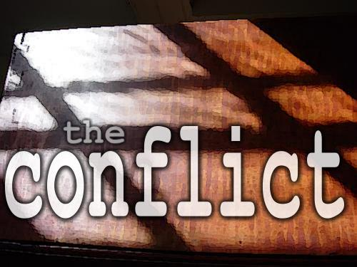
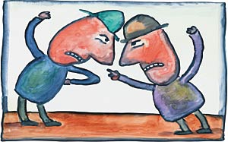
Conflict
Struggles or problems between opposing forces in the story

Slide 15
Climax
The turning point in the story where the conflict is at its peak.
Climax

Slide 16
Falling Action
The events that start to wrap up the story.
Falling Action

Slide 17
Resolution
The conflict is completely wrapped up and the story ends.
Resolution

Slide 18
PLOT DIAGRAM
Climax
Rising Action
Conflict
Falling Action
Exposition
Resolution

Slide 19
A memoir includes…
The author’s views and feels about a memorable event in his/her life
Example quote from The Latehomecomer:
“I couldn’t understand why the Hmong people had to run for their children, how their children had to make lives, again and again, in different soils, to know belonging.”
Written from the author’s perspective, about her own life
Describes her life, as well as her thoughts and feelings

Slide 20
Imperative Mood (p. 30)
A verb is in the imperative mood when it is part of a command or request. The subject is an understood “you”.
Take off your jacket and hang it up, Nurzhan.
Please stop teasing my brother.
What is the BEST way to rewrite sentence 24 in the imperative mood?
A."Wait here while we get you your kitten," he said.
B. While he got us our kitten, John told us to wait right there.
C. He said, "You should wait right here so we can get you your kitten."
D. He said, "For us to get you your kitten, you will have to wait right here."

Slide 21
Passive & Active Voice (p. 70)
Active voice: the subject performs the action
The dog walked with its owner, Steve.
Susan jumped into the pool.
Passive voice: the subject is being acted upon
The dog was walked by Steve.
Susan was surrounded by the cold water.
Ex: What is the BEST way to write this sentence in active voice without changing its meaning?
A. Our mother had finally decided to get a pet.
B. To get a pet, our mother had decided, finally.
C. Finally, a decision had been made to get a pet by our mother.
D. A decision to finally get a pet had been made by our mother.

Slide 22
Participles
A participle is when a verb is used as an adjective (p.40)
Ex: The deafening cheers shook the stadium.
When used effectively, participles are placed near the noun they modify.
Ex: Which sentence uses the participle correctly?
A. My mother took the form from smiling nodding John.
B. My mother took the form, smiling from John, nodding.
C. My mother took the form from smiling John and nodded.
D. Smiling, my mother took the form from John and nodded.

